Slide 1
Four Stroke Petrol Engine
It is based on Otto- cycle.
There are four strokes namely suction stroke, compression stroke, power stroke and exhaust stroke.
Each stroke involves 180⁰ rotation of crank shaft.
Its main feature being a petrol engine is that it needs spark plug for burning of air fuel mixture.

Slide 2
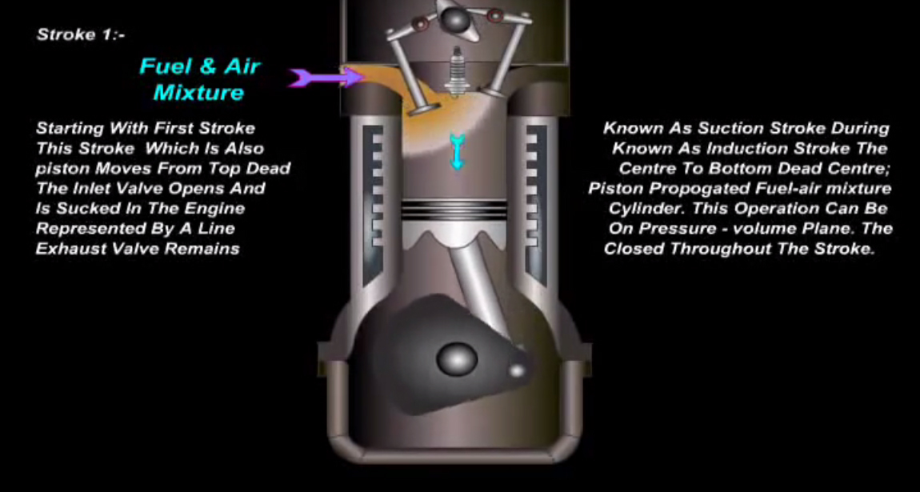
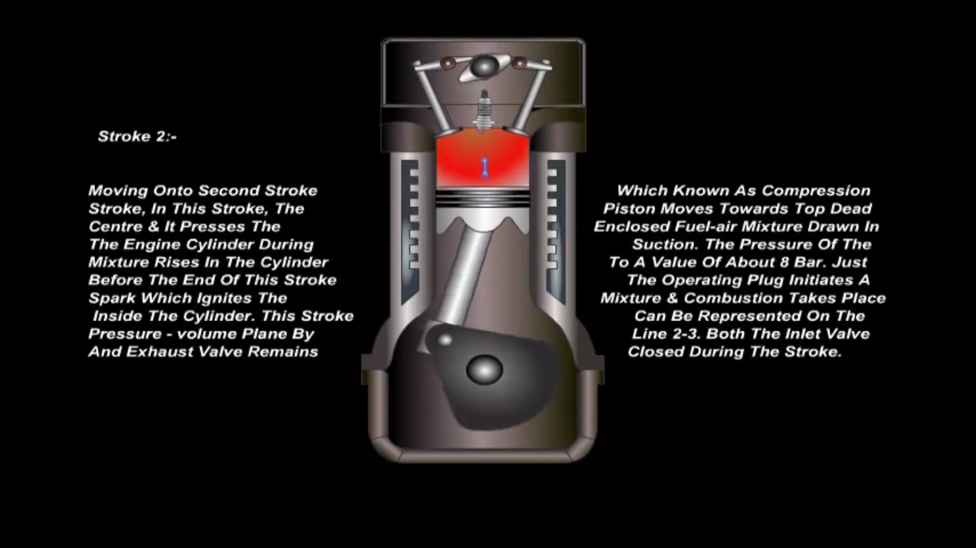
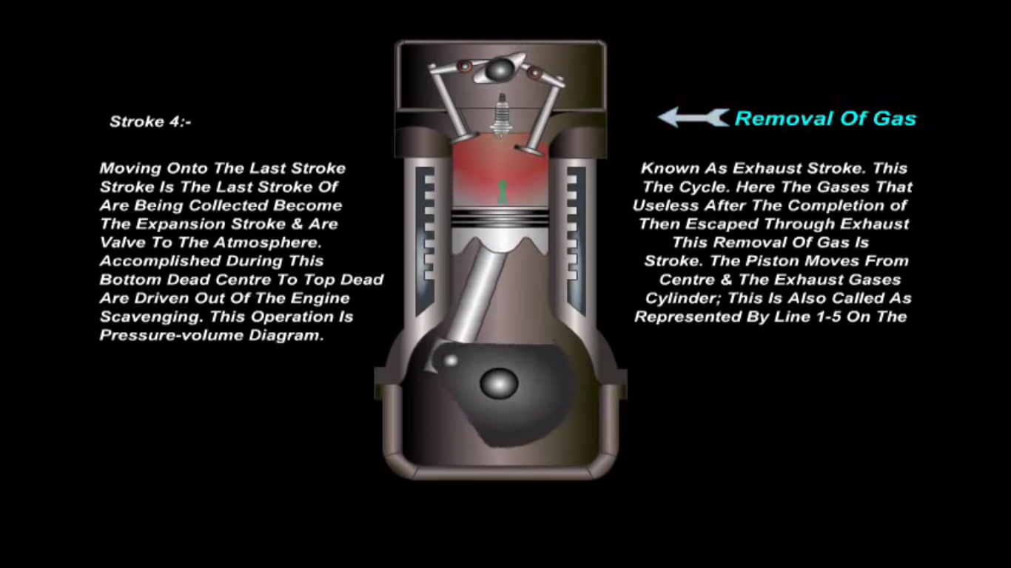

Slide 3
Four Stroke Diesel Engine
It is based on Diesel cycle.
There are four strokes namely suction stroke, compression stroke, power stroke and exhaust stroke.
Each stroke involves 180⁰ rotation of crank shaft.
Its main feature being a diesel engine is that only air is taken in suction stroke and fuel is later injected which burns itself due to high temperature. Thus spark plug is not needed.

Slide 4
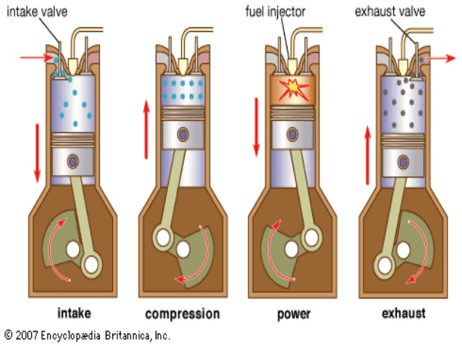

Slide 5
Two Stroke Petrol Engine
It has only two strokes for one complete cycle and each stroke involves 180⁰ rotation of crank shaft.
Suction occurs during compression stroke and exhaust occurs during power stroke.
Needs spark plug for ignition.

Slide 6
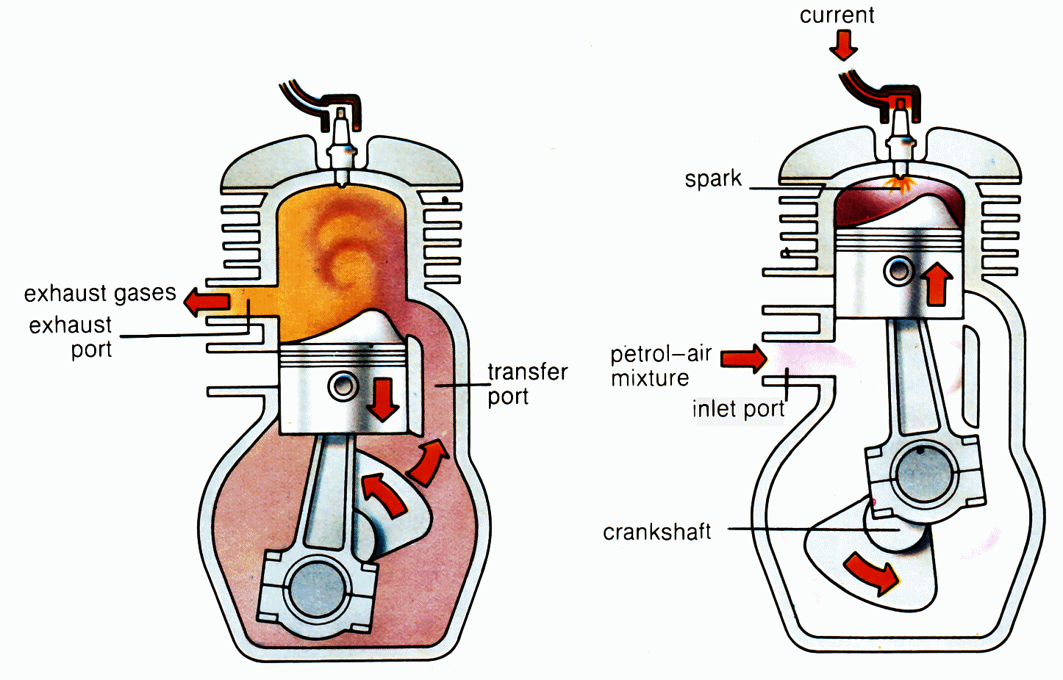

Slide 7
Two Stroke Diesel Engine
It has only two strokes for one complete cycle and each stroke involves 180⁰ rotation of crank shaft.
Suction and Exhaust is done at the end of power stroke.
Doesn’t need spark plug.

Slide 8
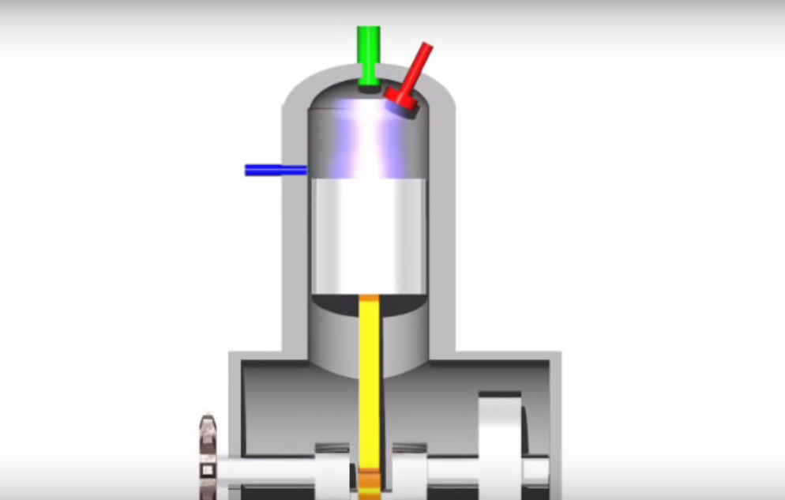
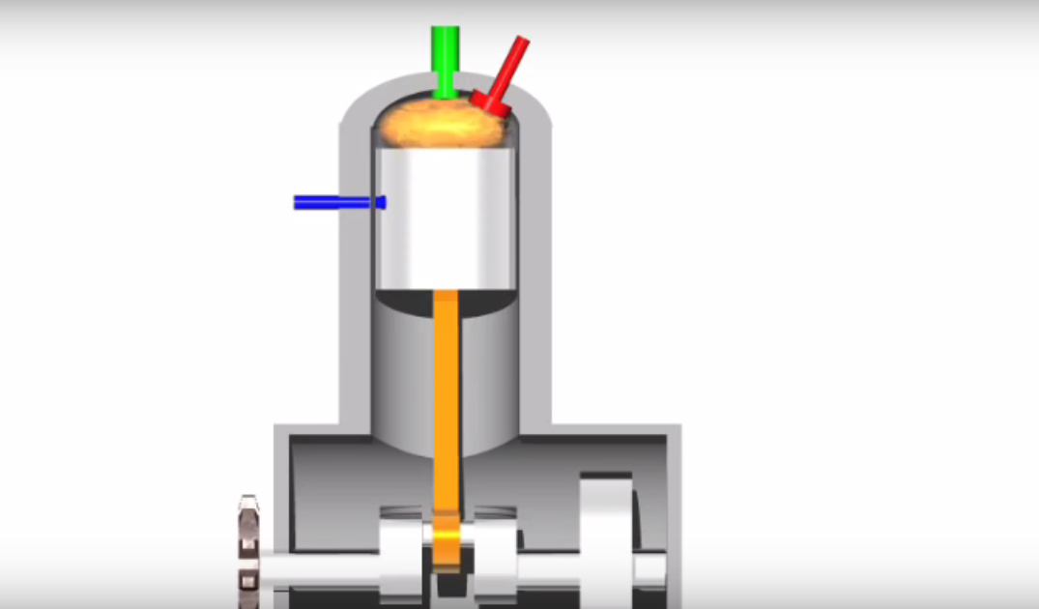
Two Stroke Diesel Engine

